Slide 1
Man vs Test Lab
Iain Brighton
September 15th 2015

Slide 2
Iain Brighton
Consultant and trainer @ Virtual Engine
Automation and End-user Computing focused consultancy
RES Consulting Partner
Avid community and open source contributor
Virtual Engine Toolkit (VET)
App-V Configuration Editor (ACE)
App-V OneGet provider
Citrix XenDesktop 7.x DSC Resources
Poor C# developer and PowerShell junkie

Slide 3
What We Will Cover
The challenge
Microsoft’s Test Lab Guides
Existing deployment options
Solution and demos
Questions and Answers

Slide 4
Disclaimer
“ Armed only with the Windows Server 2012 R2 ISO and a standalone Hyper-V host, could the deployment of Microsoft's Test Lab Guide be fully automated and deployed in under 30 minutes ”
*

Slide 5
The Real Challenge
“ Armed with the Windows Server 2012 R2 ISO, the Windows 8.1 ISO, a sprinkling of DSC resources, a standalone Hyper-V host and a little preparation; could the deployment of Microsoft's Test Lab Guide be fully automated and deployed in under 30 minutes ”
*

Slide 6
Why?
Provision Hypervisor-agnostic environments
Local deployment
Hyper-V and VMware Workstation
Cloud deployment:
Amazon Web Services and Microsoft Azure
Provision Virtual Engine Showcase and Training labs
Enable quick deployment
Support multiple product “stacks”
Utilise evaluation licenses

Slide 7
Our Current “stack”
Server 2008 R2
Active Directory
IIS
Exchange 2010
SQL 2008 R2
Citrix XenApp 6.5
RES ONE Suite
Server 2012 R2
Active Directory
IIS
Exchange 2013
SQL Server 2014
Citrix XenApp 7.6
RES ONE Suite

Slide 8
MS Test Lab Guides
Published as a Word document
Used to create a consistent lab and testing environments
Manual steps with accompanying PowerShell commands
Publically available: http://social.technet.microsoft.com/wiki/contents/articles/1262.test-lab-guides.aspx
Extended by various MS product teams
PKI, Direct Access, Branch Office and IPv6 etc.
Extendable by 3rd parties

Slide 9
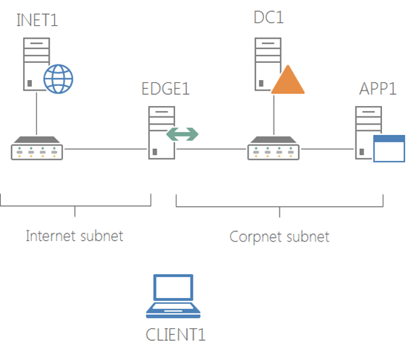
Base Configuration

Slide 10
Back in 2014..
Initial proposal
Similar to David Jones’s (@BladeFireLight) approach
1. Initialisation script
Download of prerequisites, i.e. DSC resources
Creation of parent VHDs with Convert-WindowsImage
Invoked DSC configuration
2. Host configuration with DSC
Install hotfixes and roles
Hyper-V Host
Virtual switch and Virtual machine creation
“Just” the virtual machine configuration required
Injection of DSC
Notes:
Tried: Boot from ISO:
FDD for unattend.xml
Not big enough to support required hotfixes!
Ejecting FDD?
Tried creating cutom ISO per VM:
Slow
No single-instance storage or differencing disks
Ejecting ISO?

Slide 11
Available Options
Provisioning scripts/PowerShell Workflows
Aleksander Nikolic – PowerShell Summit 2013
Microsoft Deployment Toolkit
Trond (Eric) Haavarstein’s Automation Framework +
PowerShell Deployment Toolkit
Convert-WindowsImage
Packer and Vagrant *
RES ONE Automation +
PowerShell Desired State Configuration
Notes:
MDT:
LiteTouch requires intervention
Doesn’t work in the Cloud
PDT:
Monolithic
Not a module
RES ONE Automation:
Not free

Slide 12
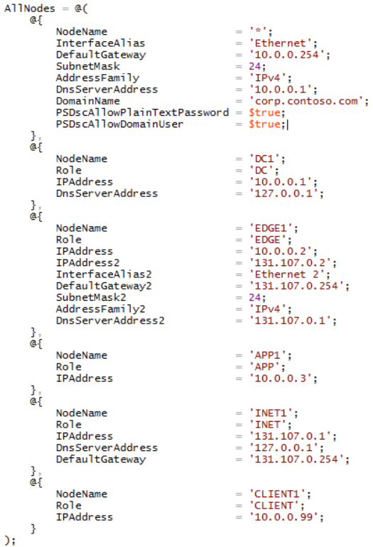
Example Environmental Configuration Data

Slide 13
Revisited in 2015..
Extend Test Lab Guide DSC document
Add metadata to configuration document
Prerequisites, images, networking and VMs
= One document!
= Configuration as Code!
Package as a module
Remove initialisation script (two passes)
Download prerequisites, i.e. ISOs and hotfixes
Avoid DSC resource conflicts

Slide 14
Example Environmental Configuration Data

Slide 15
Host Configuration
Preparing the host for lab deployment

Slide 16
Host Configuration
Utilises bundled DSC Resources
No local DSC host configuration required
Dynamically imports DSC resources
Avoids conflicts with lab DSC resources
Performs Tasks
Create required directories
Installs required roles (and hotfixes?)
Create anonymous “Resources” share *
Enable Guest account *

Slide 17
Host Configuration

Slide 18
Lab Configuration
Initialising a lab environment

Slide 19
Lab Configuration
Downloads media
Uses BITS
Creates Hyper-V virtual switches
Creates VM parent images
Expands required WIM file
Injects required Hotfixes
Creates VMs
Injects MOF, unattend.xml and bootstrap

Slide 20
Bootstrapping
Customisations
Imports certificates
Configures LCM
Invokes DSC configuration
Custom bootstrap

Slide 21
Lab Configuration

Slide 22
Lab Management
Performing life-cycle operations

Slide 23
Lab Management
Stopping and starting
Start-Lab
Stop-Lab
Lab snapshots
Checkpoint-Lab
Restore-Lab
Reverting lab
Reset-Lab
Removing lab
Remove-LabConfiguration

Slide 24
Lab Management

Slide 25
Wish List
HTTPS Pull server
Remove unsecured “Resources” share
Offline image patching
WSUSOffline integration
Injecting resources into VMs
Expansion of ZIP and ISO files, e.g. Citrix XenDesktop

Slide 26
Fast-forward to 2016..
Server 2016/PowerShell v5
OneGet and PowerShell Gallery
Published labs/composite resources
Community contributions
Partial configurations
Base Test Lab Guide
And PKI
And XenDesktop etc.
Nested Hyper-V
Integration testing with Pester anyone?
PowerShell Direct

Slide 27
What’s Next?
Now open source https://github.com/VirtualEngine/Lab
Is it worth developing?
Packer and Vagrant?
Additional “providers”
AWS CloudFormation
Azure Resource Manager Templates
VMware Workstation
Additional “lab templates”
Citrix XenDesktop 7.6

Slide 28
Kudos
“ A special thanks to Artem Pronichkin for your contributions with Convert-WindowsImage.ps1, without which, this project have been a whole lot more difficult. Kudos! “

Slide 29
How to Contact Me
Website:
virtualengine.co.uk
E-Mail:
iainbrighton@hotmail.com
Twitter:
@iainbrighton
LinkedIn:
linkedin.com/in/iainbrighton

Slide 30

Thank You
Please fill out an online session evaluation – they are an important part of making the Summit great!
Recorded sessions are posted on the PowerShell.org YouTube channel. Visit PowerShell.org for more information.

